Slide 1
UNIT IV Vector Semantics and Embeddings
By
Dr. S. S. Gharde
Dept. of Information Technology/ AIML
Government Polytechnic Nagpur

Slide 2
Contents…
Lexical Semantics, Vector Semantics, Words and Vectors
Cosine for measuring similarity, TF-IDF: Weighing terms in the vector, Pointwise Mutual Information (PMI)
Applications of the tf-idf or PPMI vector models, Word2vec, Visualizing Embeddings, Semantic properties of embeddings

Slide 3
Lexical Semantics cont…
Linguistic study of word meaning, which is called Lexical Semantics.
Dictionary meaning: mouse (N)
1. any of numerous small rodents...
2. a hand-operated device that controls a cursor...
Here the form mouse is the lemma, also called the citation form.
The form mouse would also be the lemma for the word mice
Similarly sing is the lemma for sing, sang, sung.
The specific forms sung or carpets or sing are called wordforms.

Slide 4
Lexical Semantics cont…
Each lemma can have multiple meanings.
Each of these aspects of the meaning is called word sense.
Example: the lemma mouse can refer to the rodent or the cursor control device.
The fact that lemmas can be polysemous (have multiple senses) can make interpretation difficult.

Slide 5
Lexical Semantics cont…
Synonymy One important component of word meaning is the relationship between word senses.
When one word has a sense whose meaning is identical to a sense of another word, or nearly identical, we say the two senses of those two words are synonyms.
Synonyms include such pairs as couch/sofa, vomit/throw up, car/automobile
Definition: Synonymy is that two words are synonymous if they are substitutable for one another in any sentence without changing the truth conditions of the sentence, the situations in which the sentence would be true.
In this case that the two words have the same propositional meaning.

Slide 6
Lexical Semantics cont…
Principle of contrast states that a difference in linguistic form is always associated with some difference in meaning.
Example: the word H2O is used in scientific contexts and would be inappropriate in a drinking H2O.
Here, water would be more appropriate.

Slide 7
Lexical Semantics cont…
Word Similarity: While words don’t have many synonyms, most words do have lots of similar words.
Cat is not a synonym of dog, but cats and dogs are certainly similar words.
In moving from synonymy to similarity, it will be useful to shift from talking about relations between word senses (like synonymy) to relations between words (like similarity).
The notion of word similarity is very useful in larger semantic tasks.
Knowing how similar two words are can help in computing how similar the meaning of two phrases or sentences are, a very important component of tasks like question answering, paraphrasing, and summarization.

Slide 8
Lexical Semantics cont…
Word Relatedness: The meaning of two words can be related in ways other than similarity.
One such class of connections is called word relatedness, also traditionally called word association in psychology.
Example: Consider the meanings of the words coffee and cup, scalpel and surgeon.
One common kind of relatedness between words is if they belong to the same semantic field.
A semantic field is a set of words which cover a particular semantic domain and bear structured relations with each other.
For example, words might be related by being in the semantic field of
hospitals (surgeon, scalpel, nurse, anesthetic, hospital)
restaurants (waiter, menu, plate, food, chef)
houses (door, roof, kitchen, family, bed)

Slide 9
Lexical Semantics
Semantic Frames and Roles: Closely related to semantic fields is the idea of a semantic frame.
A semantic frame is a set of words that denote perspectives or participants in a particular type of event.
Example: Buy, Sell, Pay
Connotation: Finally, words have affective meanings or connotations.
The word connotation has different meanings in different fields, but here we use it to mean the aspects of a word’s meaning that are related to a writer or reader’s emotions, sentiment, opinions, or evaluations.
For example:
positive connotations (happy), negative connotations (sad)
innocent (positive connotation) and naive (negative connotation)
positive evaluation (great, love) and negative evaluation (terrible, hate)
fake, knockoff, forgery
copy, replica, reproduction

Slide 10
Vector Semantics
Vector semantics is the standard way to represent word meaning in NLP.
The idea of vector semantics is to represent a word as a point in a multidimensional semantic space that is derived from the distributions of word neighbors.
Vectors for representing words are called embeddings.

Slide 11
Vector Semantics
What does recent English borrowing ongchoi mean?
Suppose you see these sentences:
Ong choi is delicious sautéed with garlic.
Ong choi is superb over rice
Ong choi leaves with salty sauces
And you've also seen these:
…spinach sautéed with garlic over rice
Chard stems and leaves are delicious
Collard greens and other salty leafy greens
Conclusion:
Ongchoi is a leafy green like spinach, chard, or collard greens
We could conclude this based on words like "leaves" and "delicious" and "sauteed"

Slide 12
Vector Semantics
Idea 1: Defining meaning by linguistic distribution Idea 2: Meaning as a point in multidimensional space
We define meaning of a word as a vector
Called an "embedding" because it's embedded into a space
The standard way to represent meaning in NLP
Every modern NLP algorithm uses embeddings as the representation of word meaning
Fine-grained model of meaning for similarity of vector semantics offers enormous power to NLP applications.

Slide 13
Vector Semantics
Most commonly used models
tf-idf Model
the meaning of a word is defined by a simple function of the counts of nearby words.
word2vec Model
Constructing short, dense vectors that have useful semantic properties.
The cosine Model
The standard way to use embeddings to compute semantic similarity, between two words, two sentences, or two documents, an important tool in practical applications like question answering, summarization, or automatic essay grading.

Slide 14
Words and Vectors
Vector or distributional models of meaning are generally based on a co-occurrence matrix, a way of representing how often words co-occur.
Two popular matrices:
term-document matrix
term-term matrix

Slide 15
Words and Vectors
Vectors and documents (term-document matrix)
In a term-document matrix, each row represents a word in the vocabulary and each column represents a document from some collection of documents.
Fig. 6.2 shows a small selection from a term-document matrix showing the occurrence of four words in four plays by Shakespeare.
Each cell in this matrix represents the number of times a particular word (defined by the row) occurs in a particular document (defined by the column)

Slide 16
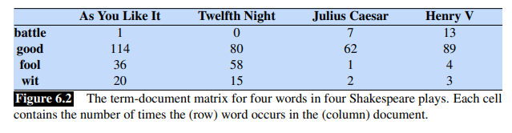
Words and Vectors
Vectors and documents (term-document matrix)
Fig. 6.2 shows a small selection from a term-document matrix showing the occurrence of four words in four plays by Shakespeare.
Each cell in this matrix represents the number of times a particular word (defined by the row) occurs in a particular document (defined by the column)

Slide 17
Words and Vectors
term-document matrix
The term-document matrix of Fig. 6.2 was first defined as part of the vector space model of information retrieval.
Term-document matrices were originally defined as a means of finding similar documents for the task of document information retrieval.
Two documents that are similar will tend to have similar words, and if two documents have similar words their column vectors will tend to be similar.
A vector space is a collection of vectors, characterized by their dimension.
A vector is, at heart, just a list or array of numbers.
So As You Like It is represented as the list [1,114,36,20] and
Julius Caesar is represented as the list [7,62,1,2]

Slide 18
Words and Vectors
term-document matrix
the term-document matrix has |V| rows (one for each word type in the vocabulary) and D columns (one for each document in the collection)
Information retrieval (IR) is the task of finding the document d from the D documents in some collection that best matches a query q.

Slide 19
More common: word-word matrix (or "term-context matrix")
Two words are similar in meaning if their context vectors are similar
Notes:
89*/An alternative to using the term-document matrix to represent words as vectors of document counts, is to use the term-term matrix, also called the word-word matrix or the term-context matrix, in which the columns are labeled by words rather than documents. This matrix is thus of dimensionality |V | × |V | and each cell records the number of times the row (target) word and the column (context) word co-occur in some context in some training corpus.
The context could be the document, in which case the cell represents the number of times the two words appear in the same document. It is most common, however, to use smaller contexts, generally a window around the word, for example of 4 words to the left and 4 words to the right, in which case the cell represents the number of times (in some training corpus) the column word occurs in such a ±4 word window around the row word. For example here is one example each of some words in their windows with counts from a Wikipedia corpus. Note that digital and information are more similar to each other than, say, to strawberry.

Slide 20
Notes:
Here's a spatial visualization of word vectors for digital and information, showing just two of the dimensions, corresponding to the words data and computer.
Of course in real life these vectors aren't just of length 2. |V |, the length of the vector, is generally the size of the vocabulary, of- ten between 10,000 and 50,000 words (using the most frequent words in the training corpus; keeping words after about the most frequent 50,000 or so is generally not helpful). Since most of these numbers are zero these are sparse vector representations; there are efficient algorithms for storing and computing with sparse matrices.

Slide 21
Cosine for measuring similarity
To measure similarity between two target words v and w, we need a metric that takes two vectors and gives a measure of their similarity.
The most common similarity metric is the cosine of the angle between the vectors.
The cosine is based on dot product operator from linear algebra, also called the inner product.
The dot product acts as a similarity metric because it will tend to be high just when the two vectors have large values in the same dimensions.
The vector length is defined as

Slide 22
Cosine for measuring similarity
Normalized dot product turns out to be the same as the cosine of the angle between the two vectors, following from the definition of the dot product between two vectors a and b:
The cosine similarity metric between two vectors v and w thus can be computed as:

Slide 23
Cosine example
 | pie | data | computer
cherry | 442 | 8 | 2
digital | 5 | 1683 | 1670
information | 5 | 3982 | 3325
The model decides that information is way closer to digital than it is to cherry, a result that seems sensible.
Notes:
Let’s see how the cosine computes which of the words cherry or digital is closer in meaning to information, just using raw counts from the following shortened table.
The model decides that information is way closer to digital than it is to cherry, a result that seems sensible.

Slide 24
TF-IDF: Weighing terms in the vector
The co-occurrence matrices we have seen represent each cell by word frequencies.
Frequency is clearly useful; if sugar appears a lot near apricot, that's useful information.
But overly frequent words like the, it, or they are not very informative about the context
How can we balance these two conflicting constraints?
There are two common solutions to this problem:
tf-idf weighting (usually used when the dimensions are documents.)
PPMI algorithm (usually used when the dimensions are words).

Slide 25
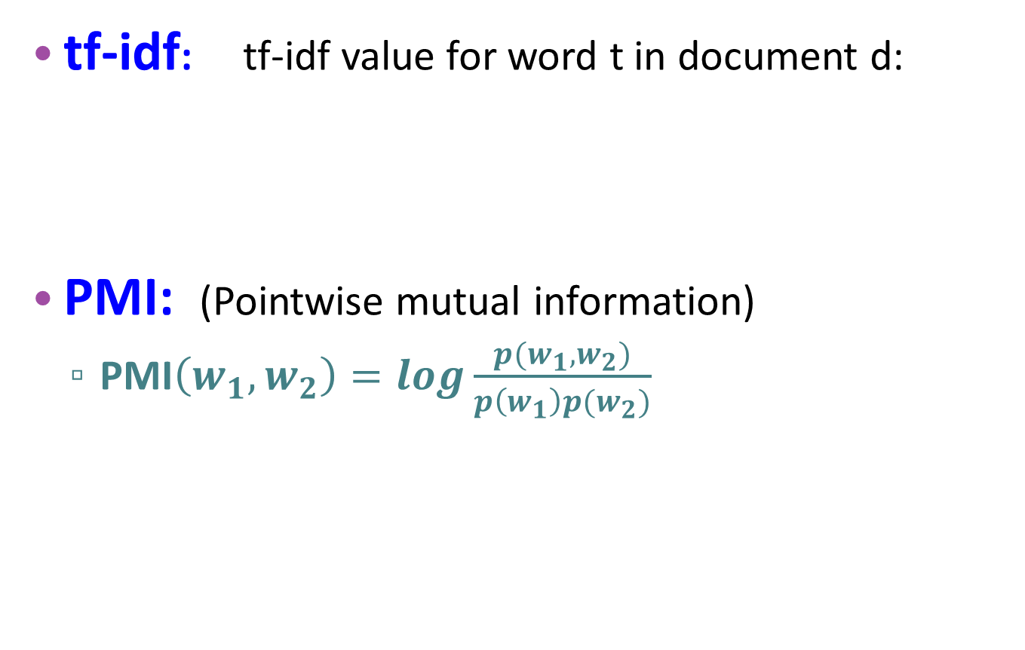
TF-IDF: Weighing terms in the vector
tf-idf: tf-idf value for word t in document d:
PMI: (Pointwise mutual information)
$\text{PMI}\left(w_{1},w_{2}\right)=log\frac{p(w_{1},w_{2})}{p\left(w_{1}\right)p(w_{2})}$
Words like "the" or "it" have very low idf
See if words like "good" appear more often with "great" than we would expect by chance
Notes:
There are two common solutions to this problem: the tf-idf algorithm, usually used when the dimensions are documents, and algorithms based on pointwise mutual information, or PMI (usually used when the dimensions are words). Tf-idf makes use of a special weight call the "inverse document frequency or "idf", to downweight words like "the" or "it". PMI is a statistical measure that compares the probabilities we see with what we would have expected by change.

Slide 26
TF-IDF: Weighing terms in the vector
The tf-idf weighting is the product of two terms Term frequency (tf) and Inverse document frequency (idf)
Term frequency (tf)
tf_{t,d} = count(t,d)
Instead of using raw count, we squash a bit:
tf_{t,d} = log₁₀(count(t,d)+1)
Document frequency (df)
df_{t} is the number of documents t occurs in.
(note this is not collection frequency: total count across all documents)
"Romeo" is very distinctive for one Shakespeare play:
Notes:
The tf-idf algorithm (the ‘-’ here is a hyphen, not a minus sign) is the product of two terms, each term capturing one of these two intuitions. The first is the term frequency: the frequency of the word t in the document d. We can just use the raw count as the term frequency: EQ
More commonly we squash the raw frequency a bit, by using the log10 of the fre- quency instead. The intuition is that a word appearing 100 times in a document doesn’t make that word 100 times more likely to be relevant to the meaning of the document. Because we can’t take the log of 0, we normally add 1 to the count:

Slide 27
TF-IDF: Weighing terms in the vector
Inverse document frequency (idf)
N is the total number of documents
in the collection
The tf-idf weighted value wt,d for word t in document d thus combines term frequency tft, d with idf.
Notes:
The tf-idf algorithm (the ‘-’ here is a hyphen, not a minus sign) is the product of two terms, each term capturing one of these two intuitions. The first is the term frequency: the frequency of the word t in the document d. We can just use the raw count as the term frequency: EQ
More commonly we squash the raw frequency a bit, by using the log10 of the fre- quency instead. The intuition is that a word appearing 100 times in a document doesn’t make that word 100 times more likely to be relevant to the meaning of the document. Because we can’t take the log of 0, we normally add 1 to the count:

Slide 28
Pointwise mutual information (PMI)
An alternative weighting function to tf-idf, positive pointwise mutual information (PPMI).
It is used for term-term-matrices, when the vector dimensions correspond to words rather than documents.
PPMI draws on the intuition that the best way to weigh the association between two words is to ask how much more the two words co-occur in our corpus than we would have a priori expected them to appear by chance.

Slide 29
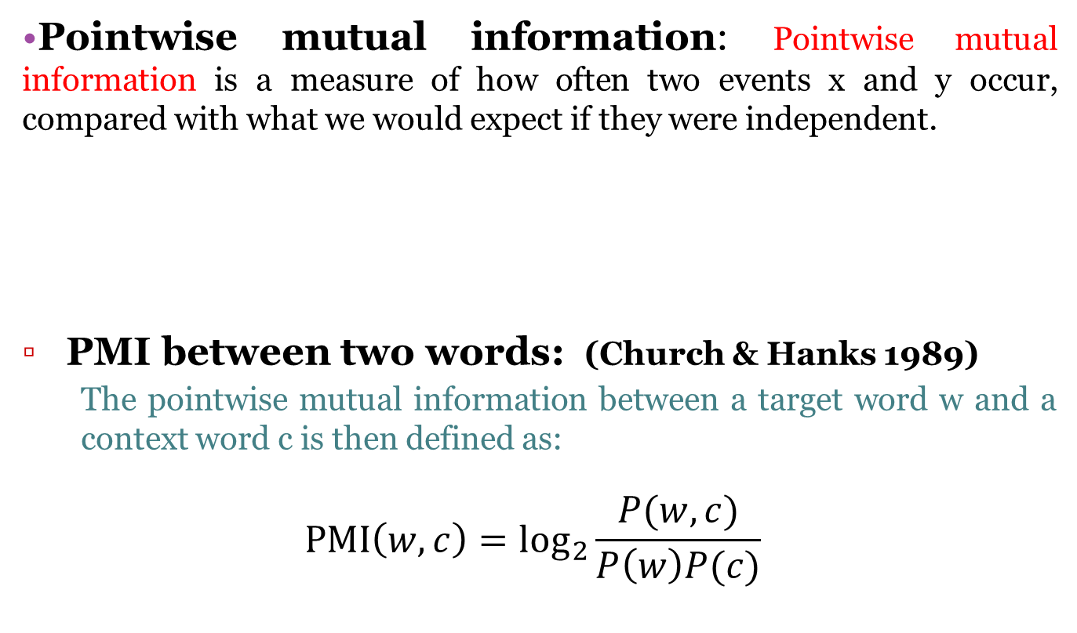
Pointwise mutual information (PMI)
Pointwise mutual information: Pointwise mutual information is a measure of how often two events x and y occur, compared with what we would expect if they were independent.
PMI between two words: (Church & Hanks 1989)
The pointwise mutual information between a target word w and a context word c is then defined as:
$$\text{PMI}\left(w, c\right)={\text{log}}_{2}\frac{P(w, c)}{P\left(w\right)P(c)}$$

Slide 30
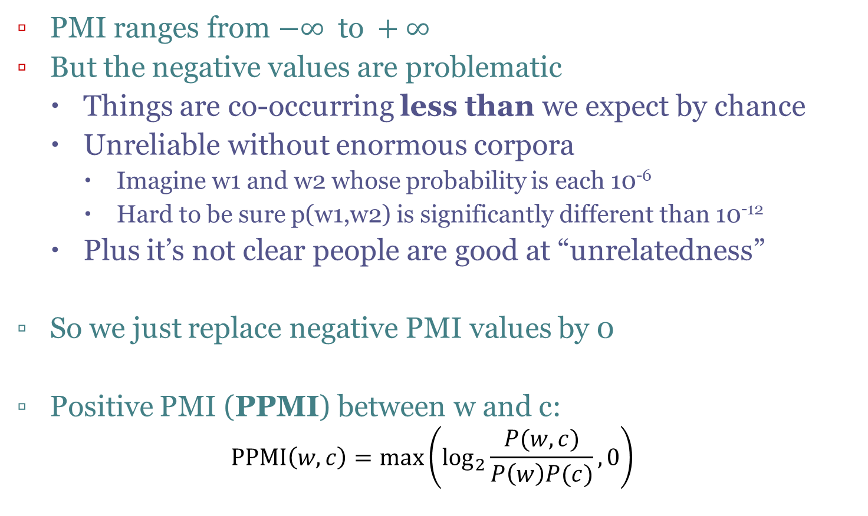
Positive Pointwise Mutual Information
PMI ranges from $−∞ \text{to} +∞$
But the negative values are problematic
Things are co-occurring less than we expect by chance
Unreliable without enormous corpora
Imagine w1 and w2 whose probability is each 10⁻⁶
Hard to be sure p(w1,w2) is significantly different than 10⁻¹²
Plus it’s not clear people are good at “unrelatedness”
So we just replace negative PMI values by 0
Positive PMI (PPMI) between w and c:
$$\text{PPMI}\left(w, c\right)=\max\left({\text{log}}_{2}\frac{P(w, c)}{P\left(w\right)P(c)},0\right)$$

Slide 31
Computing PPMI on a term-context matrix
Matrix F with W rows (words) and C columns (contexts)
f_{ij} is number of times w_{i} occurs in context c_{j}

Slide 32
p(w=information, c=data) =
p(w=information) =
p(c=data) =
3982/11716
= 0.3399
7703/11716
= 0.6575
5673/11716
= 0.4842
PPMI(information, data) = log₂ (
0.3399 /
(0.6575*0.4842) )
= 0.0944

Slide 33
Applications of the tf-idf or PPMI vector models
The tf-idf model of meaning is often used for document functions like deciding if two documents are similar.
Document similarity is also useful for all sorts of applications:
Information retrieval
Plagiarism detection
News recommender systems
Even for digital humanities tasks like comparing different versions of a text to see which are similar to each other.
Either the PPMI model or the tf-idf model can be used to compute word similarity, for tasks like:
Finding word paraphrases
Tracking changes in word meaning
Automatically discovering meanings of words in different corpora.

Slide 34
Word2vec
tf-idf (or PMI) vectors are
long (length |V|= 20,000 to 50,000)
sparse (most elements are zero)
Alternative: learn vectors which are
short (length 50-1000)
dense (most elements are non-zero)
Dense vectors work better in every NLP task than sparse vectors.
Short vectors may be easier to use as features in machine learning (fewer weights to tune)
Idea: predict rather than count

Slide 35
Word2vec
One method for computing embeddings: skip-gram with negative sampling, sometimes called SGNS.
The skip-gram algorithm is one of two algorithms in a software package called word2vec
Sometimes the algorithm is loosely referred to as word2vec.
The word2vec methods are fast, efficient to train, and easily available online with code and pretrained embeddings.
Word2vec embeddings are static embeddings.

Slide 36
Word2vec: Skip-gram classifier
A probabilistic classifier, given
a test target word w
its context window of L words c_{1:L}
Estimates probability that w occurs in this window based on similarity of w (embeddings) to c_{1:L} (embeddings).
To compute this, we just need embeddings for all the words.
Notes:
In summary, skip-gram trains a probabilistic classifier that, given a test target word w and its context window of L words c1:L, assigns a probability based on how similar this context window is to the target word. The probability is based on applying the logistic (sigmoid) function to the dot product of the embeddings of the target word with each context word. To compute this probability, we just need embeddings for each target word and context word in the vocabulary.

Slide 37
Word2vec: Skip-gram classifier

Slide 38
Visualizing Embeddings
Visualizing embeddings is an important goal in helping understand, apply, and improve these models of word meaning.
The simplest way to visualize the meaning of a word w embedded in a space is to list the most similar words to w by sorting the vectors for all words in the vocabulary by their cosine with the vector for w.
For example the 7 closest words to frog using the GloVe embeddings are:
frogs, toad, litoria, leptodactylidae, rana, lizard, and eleutherodactylus

Slide 39
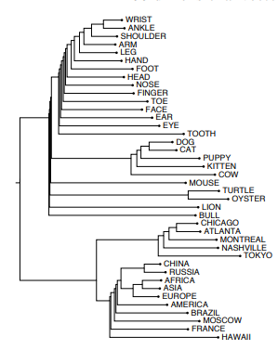
Visualizing Embeddings
Another visualization method is to use a clustering algorithm to show a hierarchical representation of which words are similar to others in the embedding space.

Slide 40
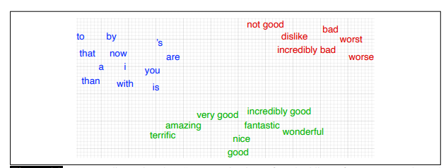
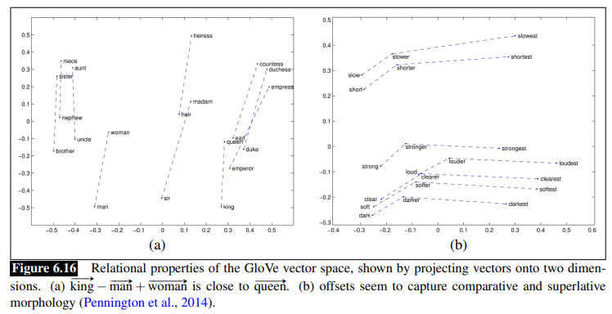
Visualizing Embeddings
The most common visualization method is
to project the 100 dimensions of a word down into 2 dimensions

Slide 41
Semantic properties of embeddings
Different types of similarity or association:
Two kinds of similarity or association between words
Two words have first-order co-occurrence (sometimes called syntagmatic association) if they are typically nearby each other.
Thus wrote is a first-order associate of book or poem.
Two words have second-order co-occurrence (sometimes called paradigmatic association) if they have similar neighbors.
Thus wrote is a second-order associate of words like said or remarked.

Slide 42
Semantic properties of embeddings
Analogy/Relational Similarity:
Another semantic property of embeddings is their ability to capture relational meanings.
In an important early vector space model of cognition, proposed the parallelogram model for solving simple analogy problems of the form a is to b as a* is to what?.

Slide 43
End of UNIT IV

